Slide 1
The Clean Architecture with .NET Core
by Nikolay Dermendzhiev
Software Developer @ZingaSoft
Leader @.NET Bulgaria
https://dotnetug.bg/

Slide 2

Thank you for your partnership

Slide 3

Thank you for your partnership

Slide 4

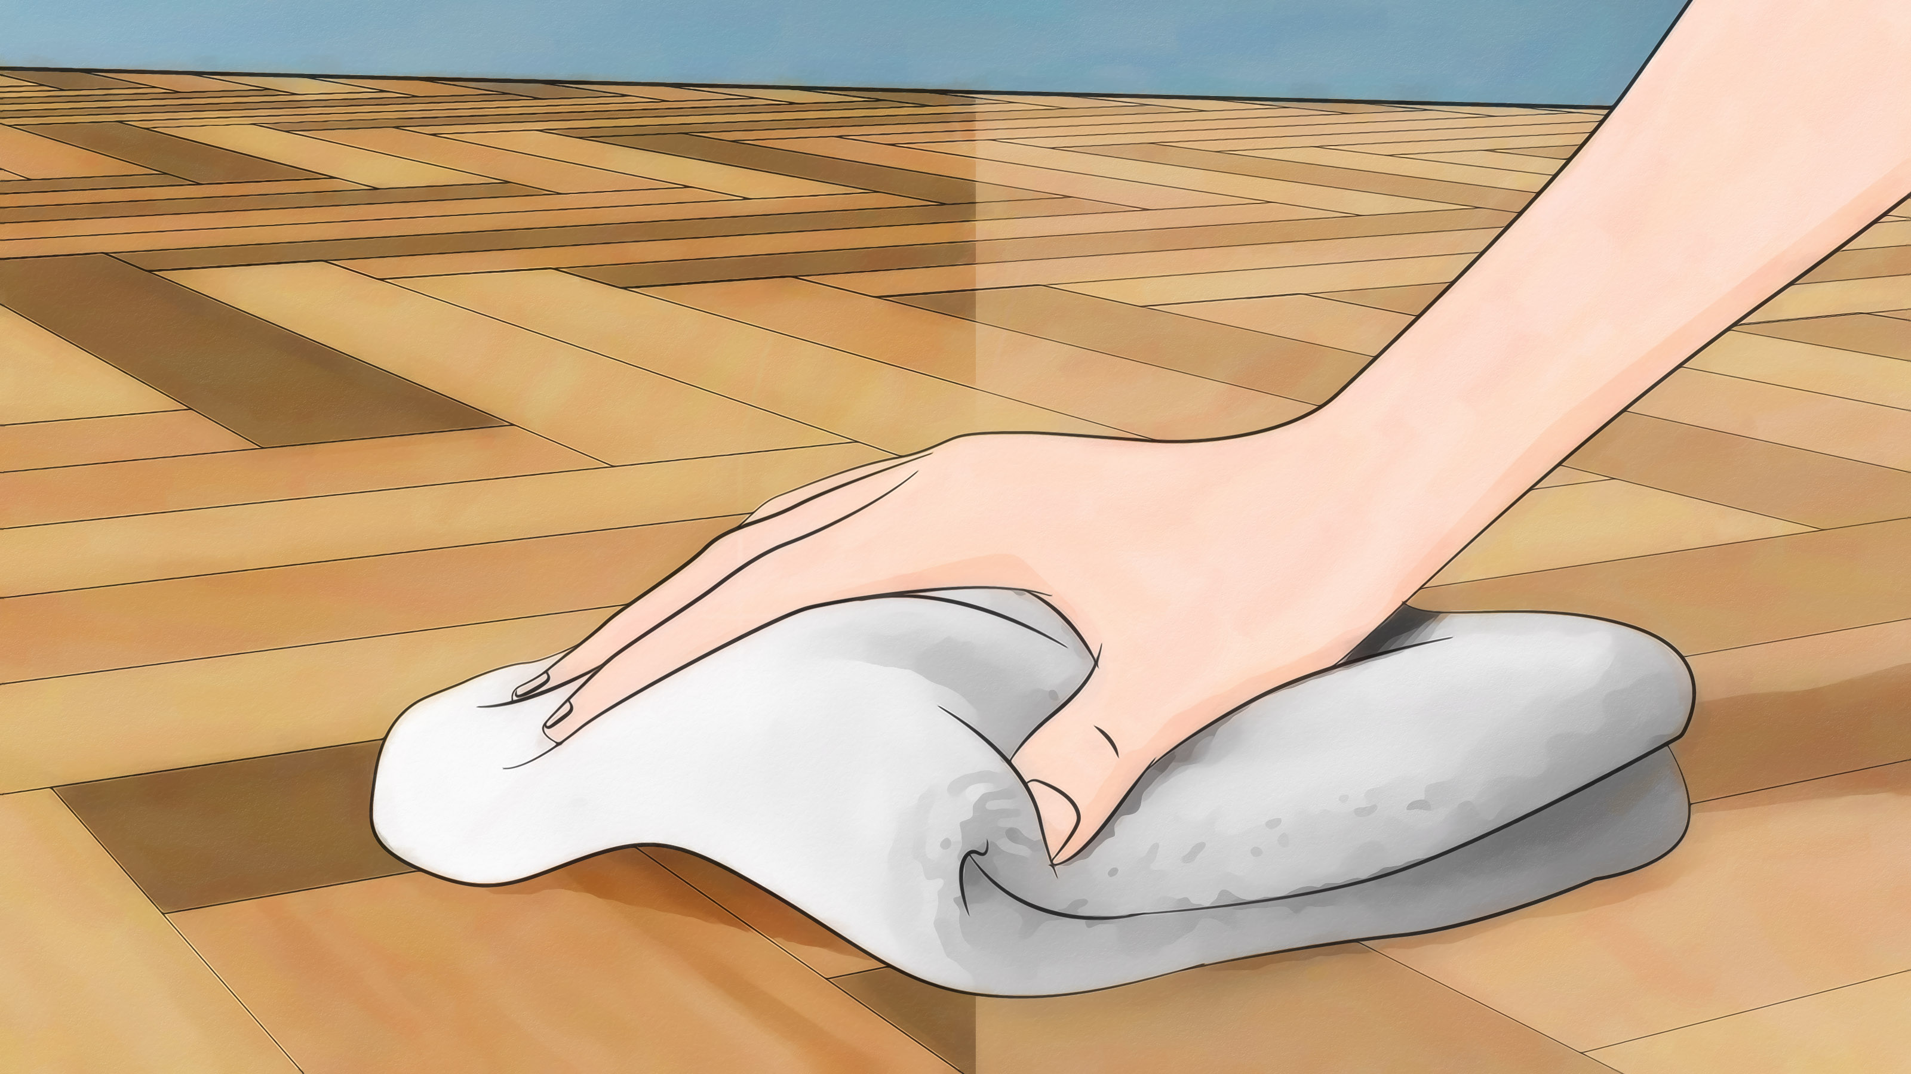

Slide 5
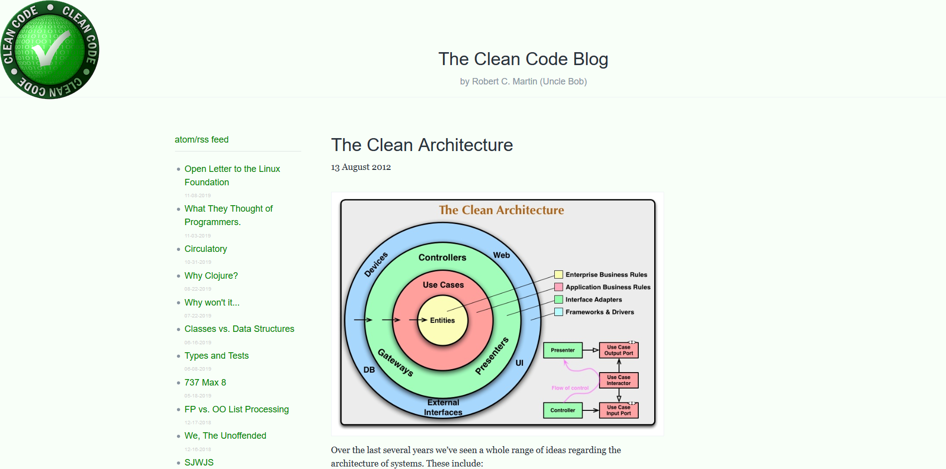
It’s the Clean Architecture, Not a Clean Architecture
https://blog.cleancoder.com/uncle-bob/2012/08/13/the-clean-architecture.html

Slide 6
Agenda
Traditional database-centric vs domain-centric approaches
Domain-centric architecture types
The Clean Architecture
Screaming Architecture

Slide 7

TRADITIONAL DATABASE-CENTRIC vs DOMAIN-CENTRIC

Slide 8
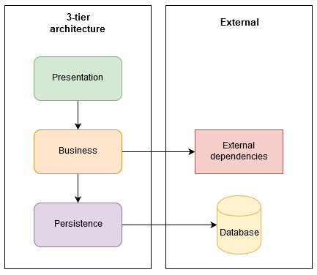
Traditional database-centric approach
Traditional architecture
Presentation layer
Business layer
Data access layer
Database
Database is in the center
Application code is often considered to be secondary

Slide 9

DEMO

Slide 10
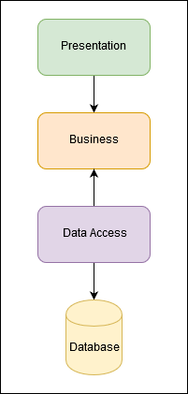
Domain-centric approach
Domain and use cases are essential
All dependencies point towards the domain
inversion of control
Presentation and databases are just a detail

Slide 11
DEMO

Slide 13
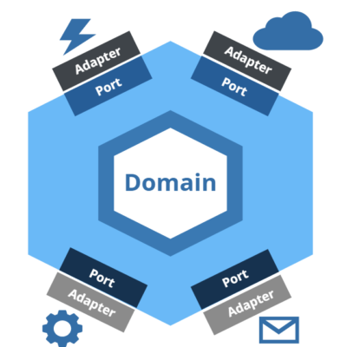
Domain-centric architecture types
Hexagonal Architecture (a.k.a. Ports and Adapters)

Slide 14
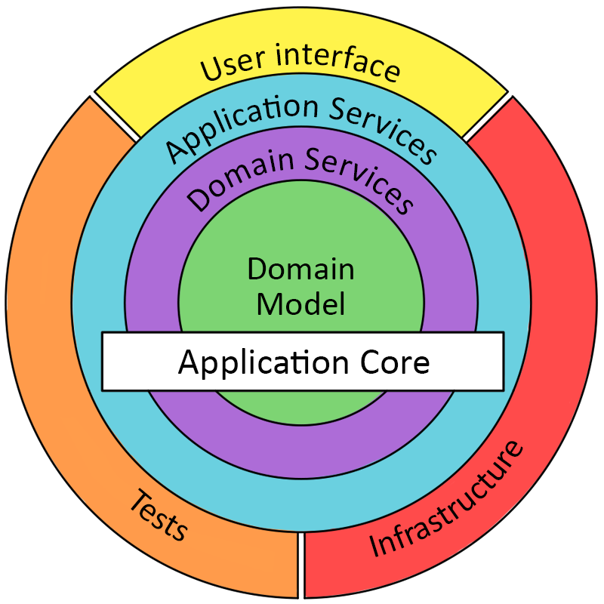
Domain-centric architecture types (2)
The Onion Architecture

Slide 15
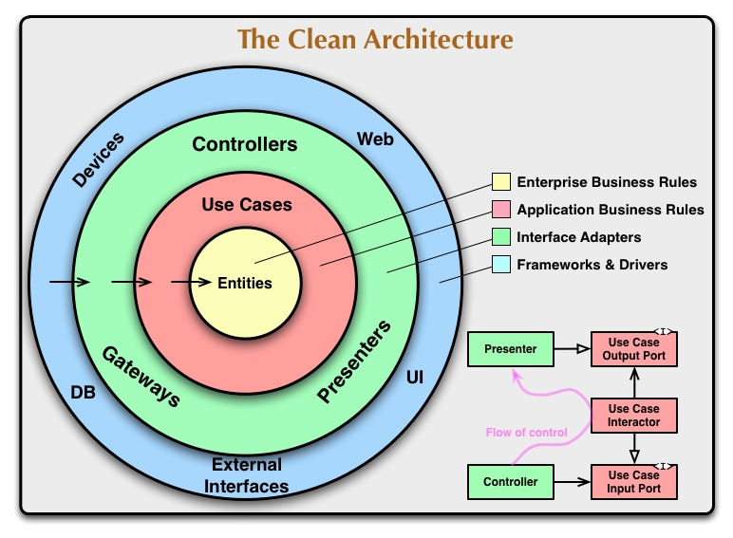
Domain-centric architecture types (3)
The Clean Architecture

Slide 16
Summary
Database-centric
dependencies are pointing towards the database
Domain-centric
domain and use cases are essential
database is a detail
Various domain-centric architectures types

Slide 17
THE CLEAN ARCHITECTURE

Slide 18
The Clean Architecture
Independent of frameworks
Testable
Independent of UI
Independent of database
Independent of any external agency

Slide 19

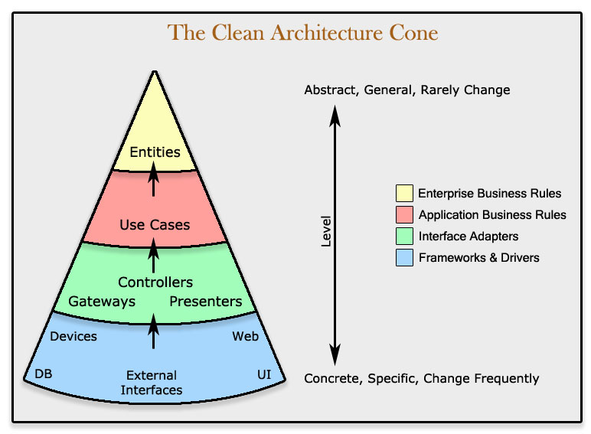
The dependency rule
Dependencies can only point inwards

Slide 20
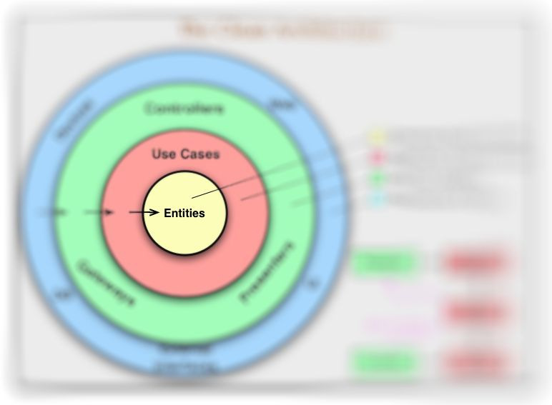
Entities

Slide 21
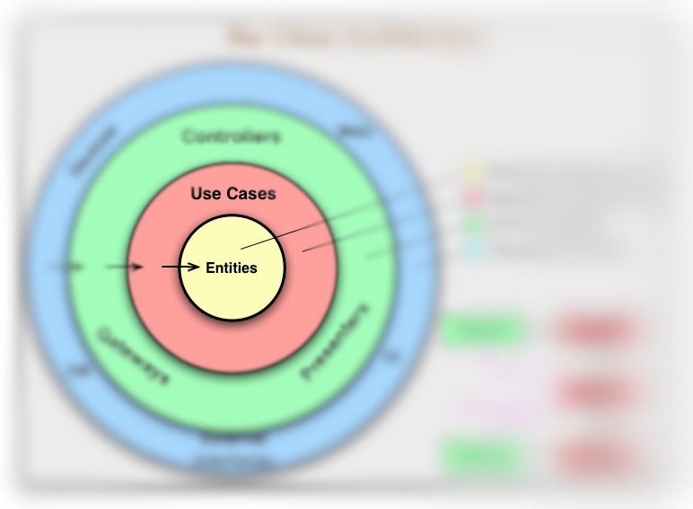
Use Cases

Slide 22
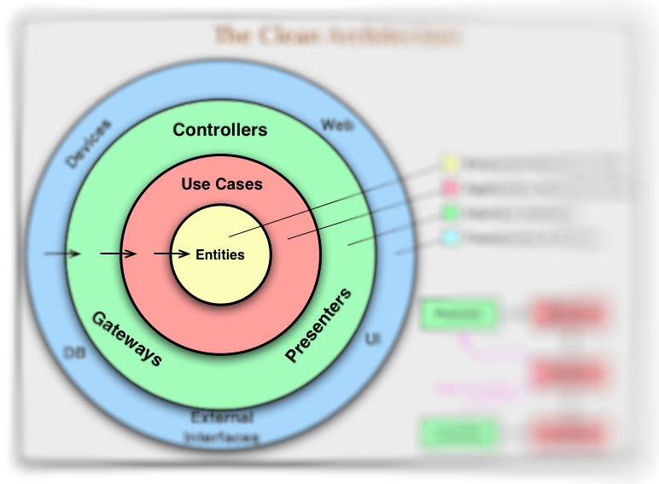
Interface Adapters

Slide 23
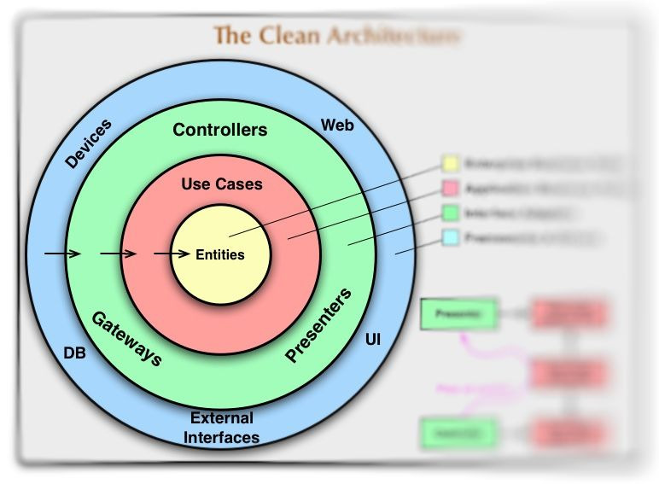
Frameworks and Drivers

Slide 24
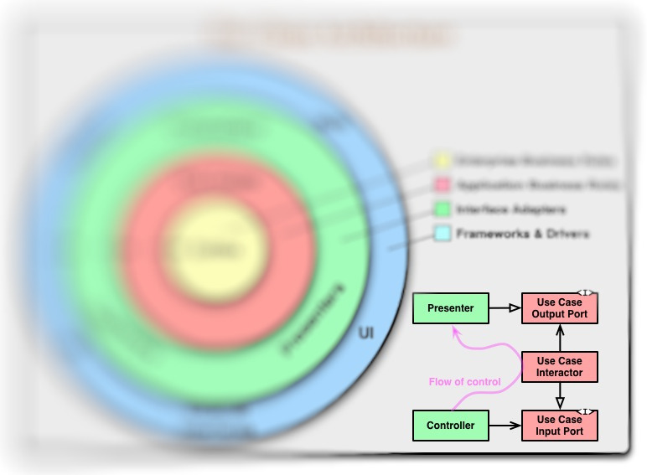
Crossing boundaries

Slide 25

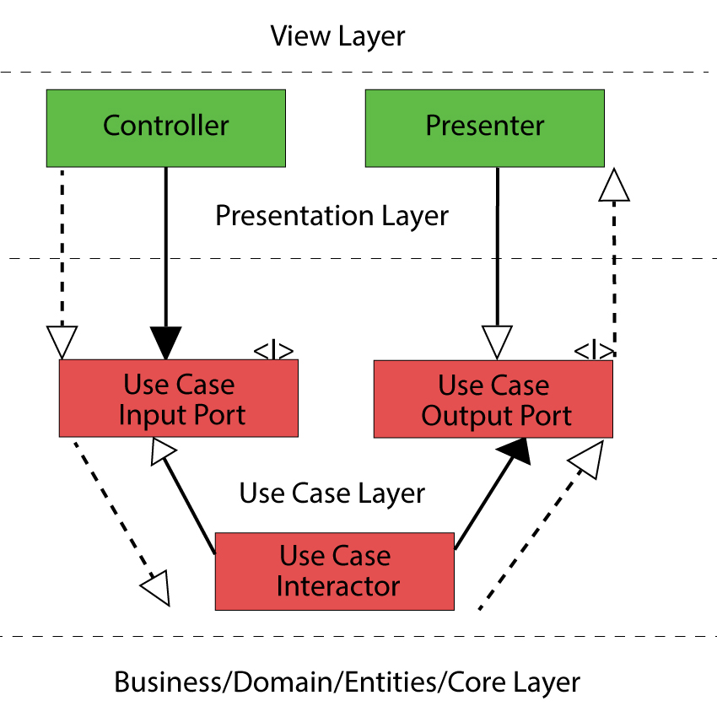


Crossing boundaries (2)
Uses an interface implementation, composition, has-a relation
Implements an interface
Shows a real flow of execution, from the programming point of view it could be represented as a stack of function calls

Slide 26
DEMO

Slide 27
Flavors and variations
Naming conventions
IGetClientInputPort vs IGetClientUseCase vs IGetClient vs IGetClientService
IClientGateway vs IClientRepository
Exceptions/result objects/output port
Handling use case result inside the presenter
Present vs Handle vs Success/Fail vs Found/NotFound/Created/Updated
Use of base classes and interfaces inside application

Slide 28
The Clean Architecture
Benefits
Independence of frameworks and tools (UI, DB, infrastructure, 3rd party)
Excellent testability
Clear separation of concerns
Downsides
More complex
Lots of additional code (classes and interfaces)
More DTOs and conversions
Violations
Depending on frameworks, UI, database, external agency
Where can it be applied?
Almost everywhere

Slide 29
SCREAMING ARCHITECTURE

Slide 30
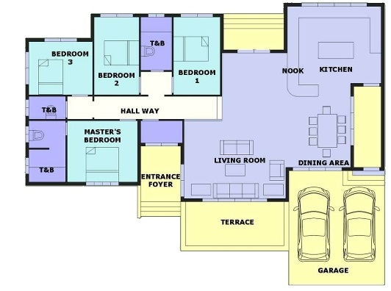

Slide 31
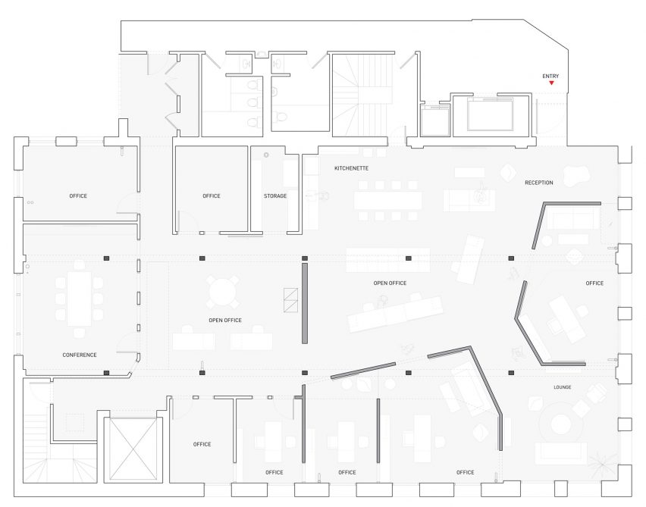

Slide 32
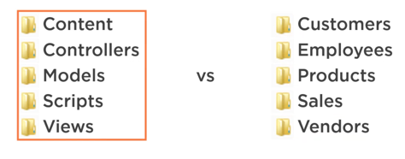
Screaming Architecture
Good architectures are centered around use-cases
Your architectures should tell readers about the system, not about the frameworks

Slide 33
DEMO

Slide 34
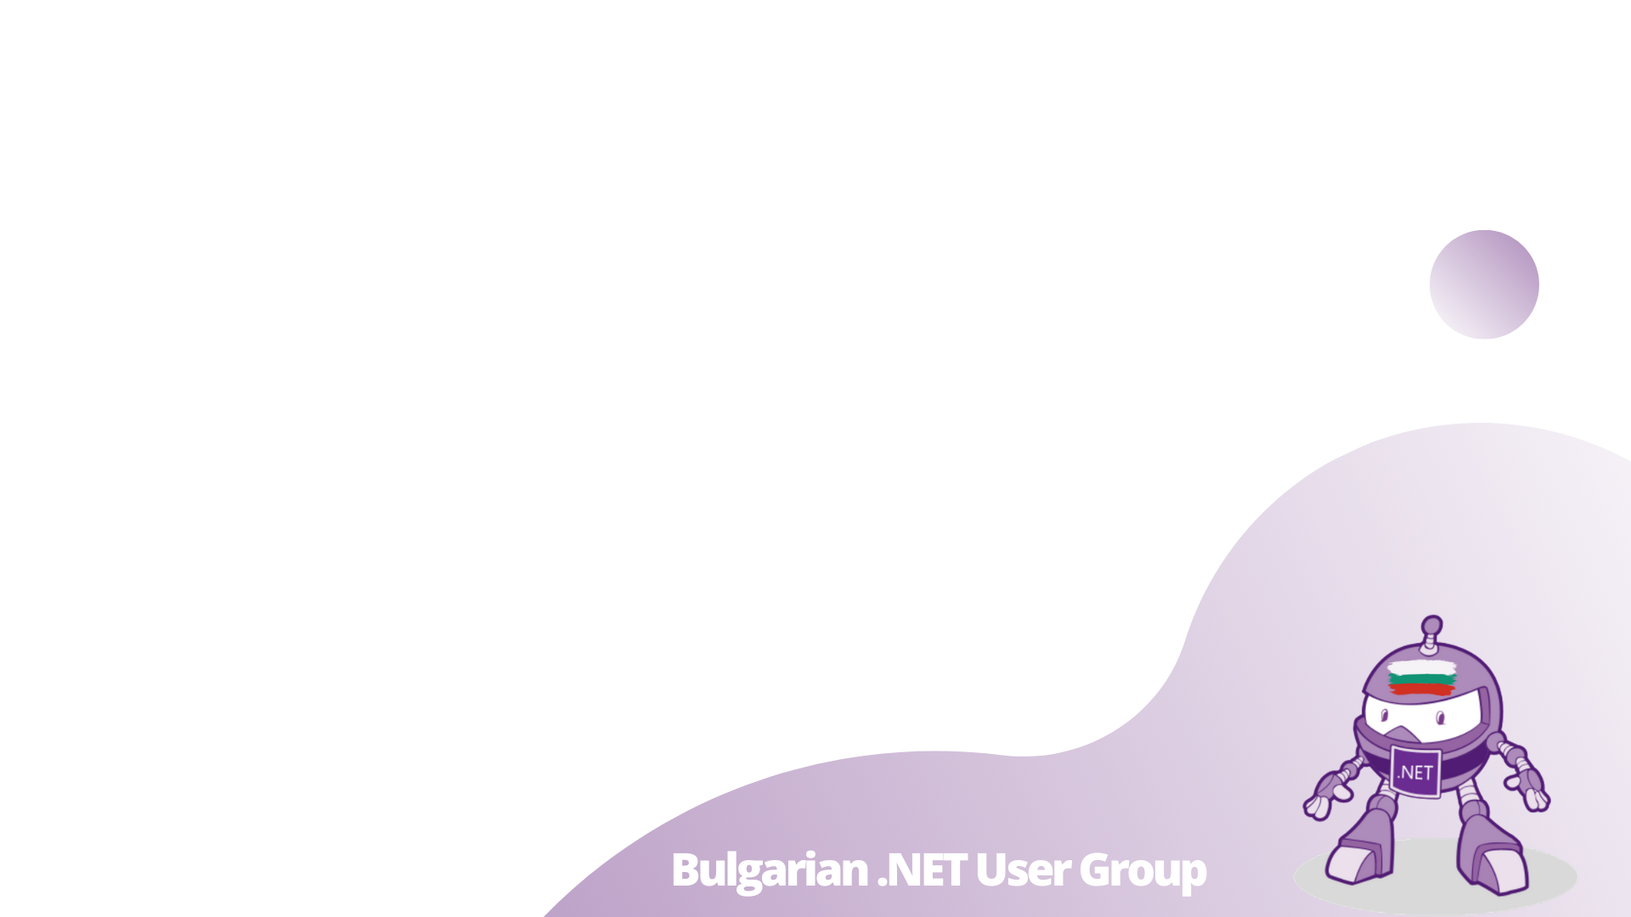
Questions

Slide 35
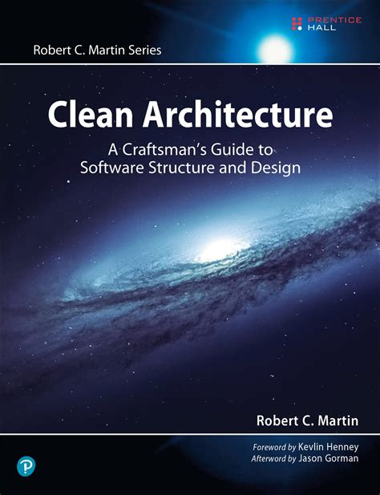

Slide 36
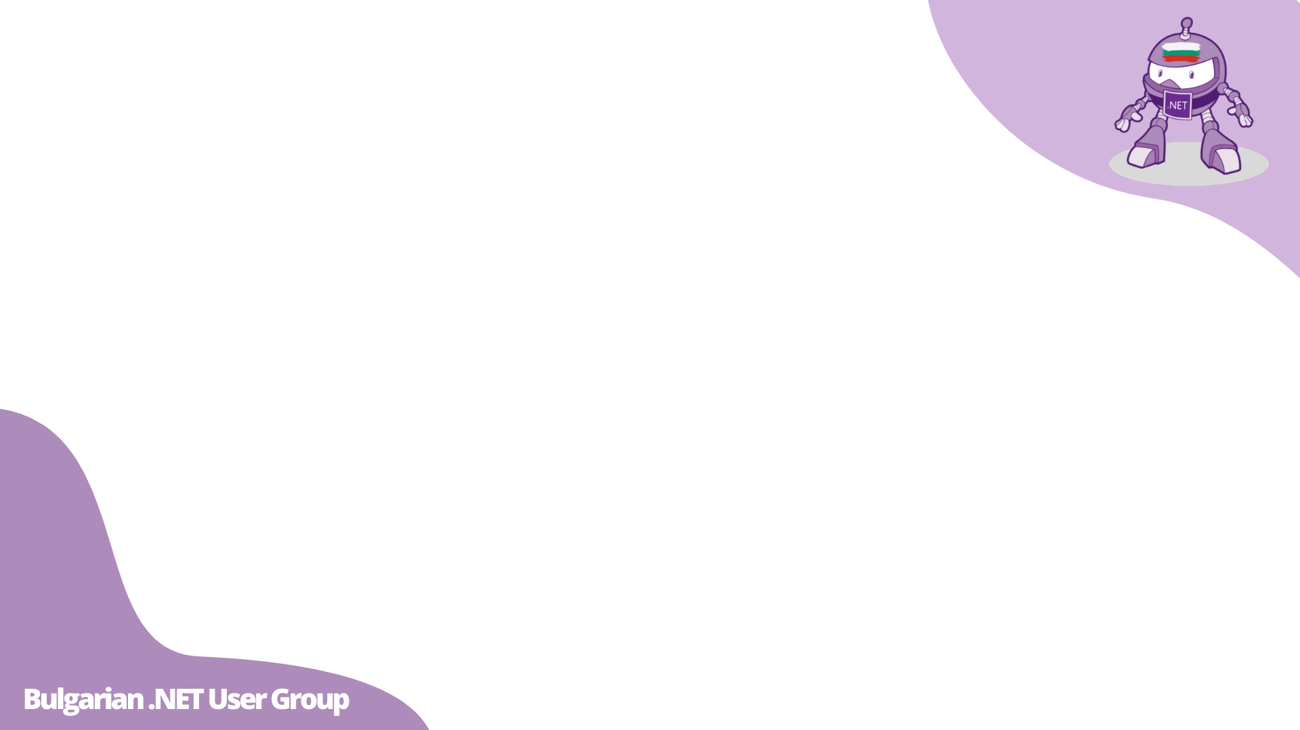
Resources
The Clean Architecture [article]
Clean Architecture: A Craftsman's Guide to Software Structure and Design (Robert C. Martin Series) [book]
The Principles of Clean Architecture by Uncle Bob Martin [video]
Clean Architecture: Use case containing the presenter or returning data? [question]
A button, as a “Clean Architecture” plugin [code review]
Clean Code Case Study [demo project]
Entity—Boundary—Interactor [collection of articles]
Screaming Architecture [article]
Clean Architecture – Make Your Architecture Scream [podcast]
Feature Folder Structure in ASP.NET Core [article]
Database-centric vs domain-centric architecture in ASP.NET Core 3.0 [demo project]
Clean Architecture in ASP.NET Core [demo project]
Humble Object [article]

